Slide 1
Ambientes & Cursos
JS4Girls Recife

Slide 2


Slide 3



Editores
Atom
Notepad++
Sublime
Notes:
Atom: Atom
Sublime: Sublime Text: The text editor you'll fall in love with
NotePad++: Notepad++ Home

Slide 4
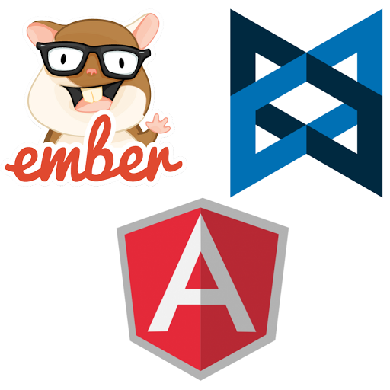

FrameWorks JS
ember
Backbone.js
Node.js
Angular.js
Notes:
Node.js: Node.js
Ember: Ember.js - A framework for creating ambitious web …
Backbone: Backbone.js
Angular.js: AngularJS — Superheroic JavaScript MVW Framework

Slide 5



Escolas de Programação Online
code.org
Notes:
Code.org: Code.org: Anybody can learn
Code Academy: Learn To Code
Code Schooll: https://www.codeschool.com/courses#all

